Slide 1
Evaluation and efficiency monitoring of the new implemented sewage network and wastewater treatment construction in the larger city of Poreč.
Wastewater treatment modelling and operational assessment
Project final presentation
ASM Design B.V.
Sebastian Meijer PhD MSc

Slide 2
Content of this presentation
Contexts
General project approach
Quick introduction on WWTP modelling
Some applied methods
Conclusions challenges and recommendations
Finalizing training

Slide 3
Contexts
Main contexts: Infrastructural investment Sewerage and Wastewater Treatment Plants of City of Poreč – Project Poreč.
Related project: Integrated Modelling of Wastewater Infrastructure System of City of Poreč – Modelling Project.
The modeling project has 4 components:
Modelling the sewage transport system,
Modelling performance of 4 treatment systems (WWTPs),
Modelling impact on aquatic water quality,
Establishment laboratory setup for monitoring and optimization.
This presentation discusses the part wastewater treatment modeling

Slide 4
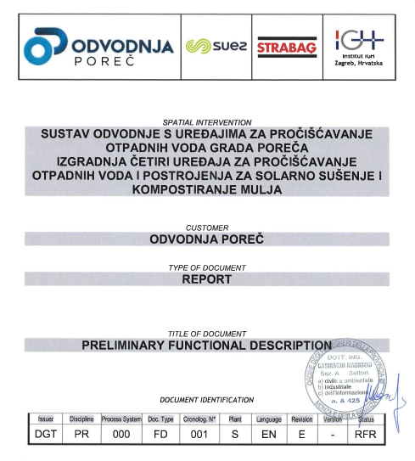
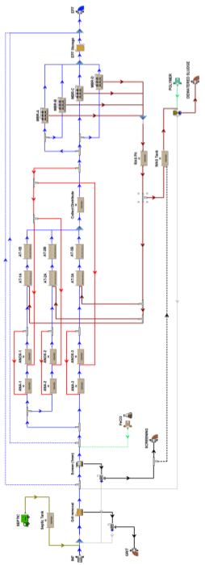
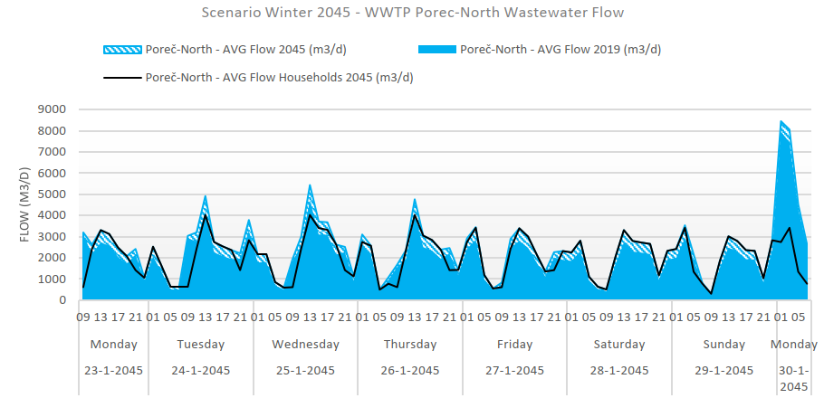
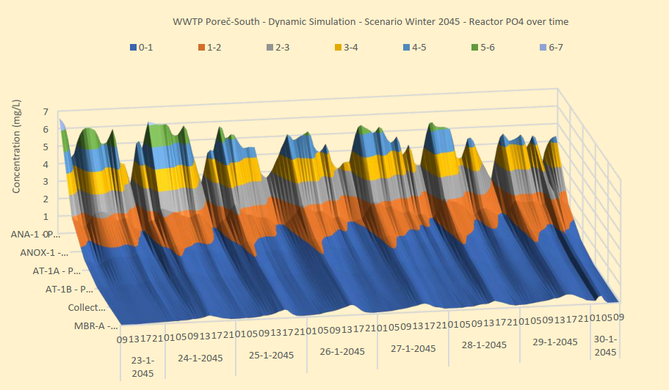
General steps in the modelling project
Static design documentation
Influent measurements
Seawater quality modeling
Transport modeling
Static and dynamic WWTP modelling
Dynamic scenario study

Slide 5
General project approach
Modeling 4 wastewater treatment plants based on the detailed design (report 5.1 to 5.4)
Dynamic wastewater treatment modeling based on winter and summer influent measurements (2019) (report 6.1 to 6.4)
Analysis of operational scenarios up to the year 2045 including rain events (report 7.1 to 7.4)
Model validation based on 2022 operational data (report 8.1 to 8.4)
Training the technological team of Odvodnja Poreč in the use of BioWin software and model-based plant assessment (report 9)

Slide 6
Quick introduction on WWTP modelling
WWTP model; A combination of several models
Model input; Influent flow and concentrations (lab measurements)
Influent specification; Dividing totals in fractions (characterization)
Hydraulic model; Modelling water flows in the WWTP
Separation model; Modelling the membrane reactors (or sedimentation)
Mixing model; According to complete mixed tank reactors (CSTR)
Activated sludge model; Combination of stoichiometry (A+B=C) and kinetics (speed of reaction)
Model output; Calculated result of the scenario study under which effluent results

Slide 7
Method of assessment
Project definition: Dynamic WWTP effluent flow and load prediction as input for sea water quality modeling
Model setup: Model including dynamic influent, process control and discontinues sludge dewatering
Data acquisition: Influent measurements 7 days 24-hours, data evaluation based on influent specification modelling
Simulation and calibration: Static and dynamic WWTP simulation using BioWin
Retrofit and validation: Retrofit of the detailed design including calibration. Model validation based on 2022 operational data
WWTP assessment: Operational assessment based on design parameters, required effluent quality, tested under static and dynamic conditions
Scenario study: Scenario’s based on 2045 load projection, rain weather operation, summer and winter conditions

Slide 8
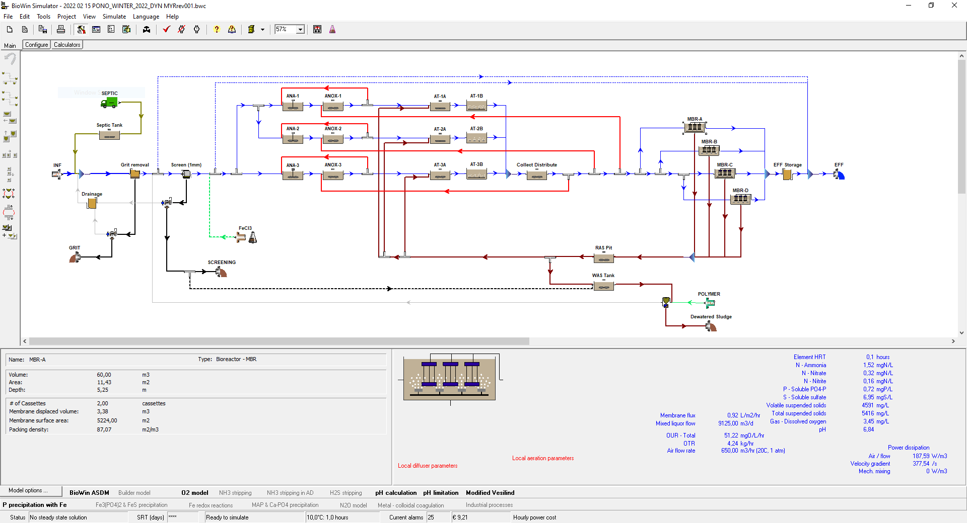
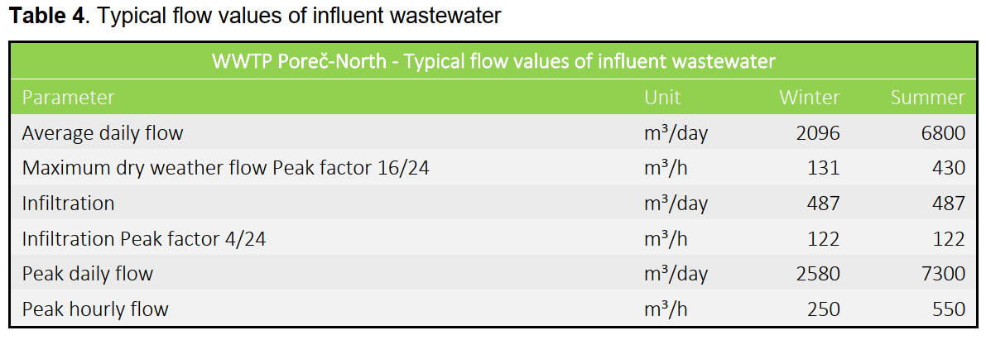
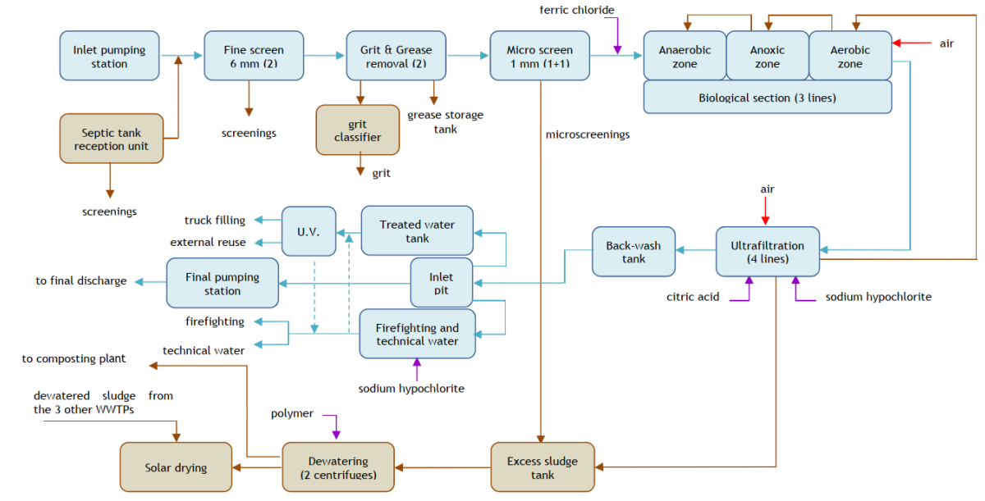
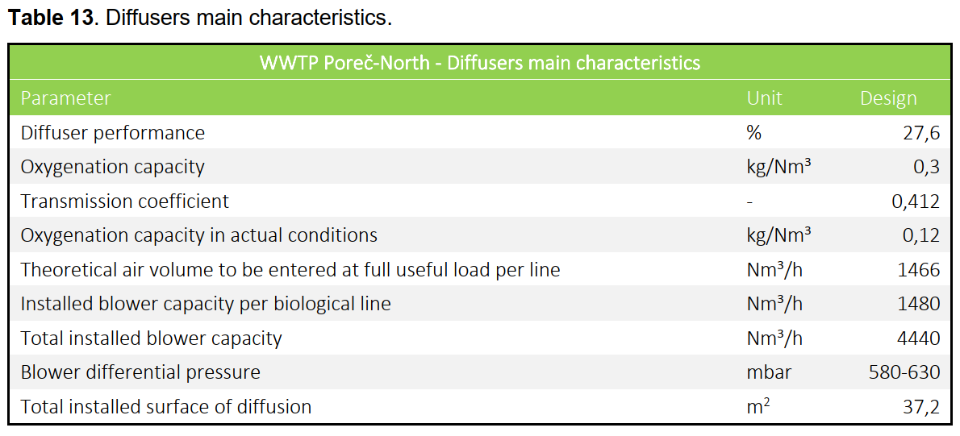
Static design retrofit using BioWin simulation software
Model construction and static design retrofit

Slide 9
Influent specification modelling
Preparing influent measurements for modelling
Determining soluble, particulate, biodegradable and non-biodegradable fractions
Matching fractions to typical domestic source
Detecting industrial or unusual influent composition
Assessment of domestic load versus total load including commercial
Assessment of sewage “strange” water; Infiltration of ground or surface water
influent
decanted
precipitated
filtered
Me-salt
0,45 µm
total
soluble + colloidal
soluble
soluble

Slide 10
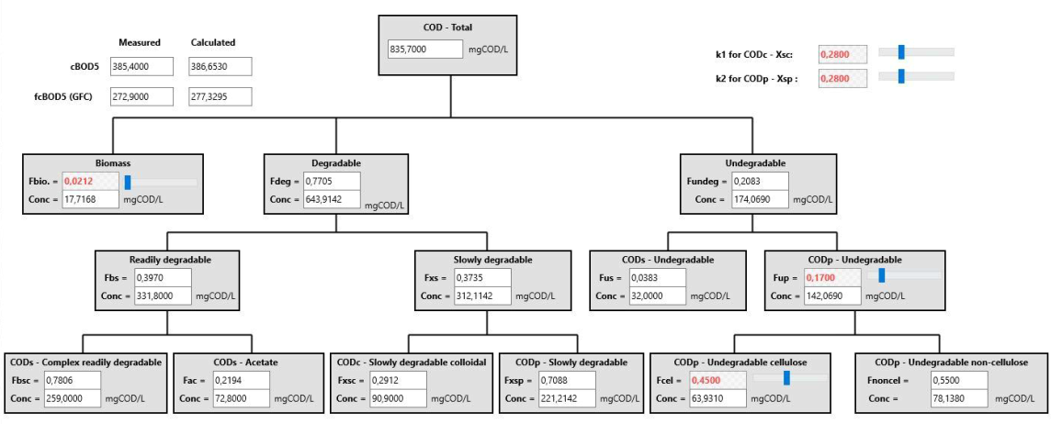
Influent specification modelling
Influent fractions are calculated for model input and checked

Slide 11
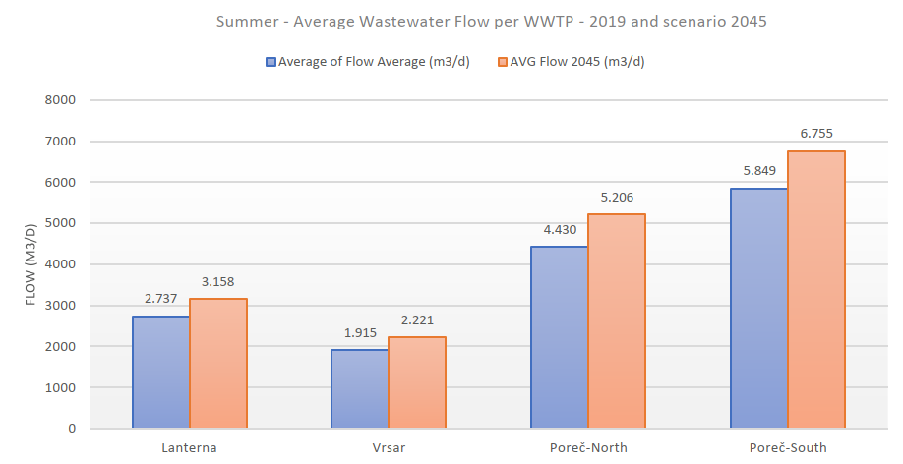
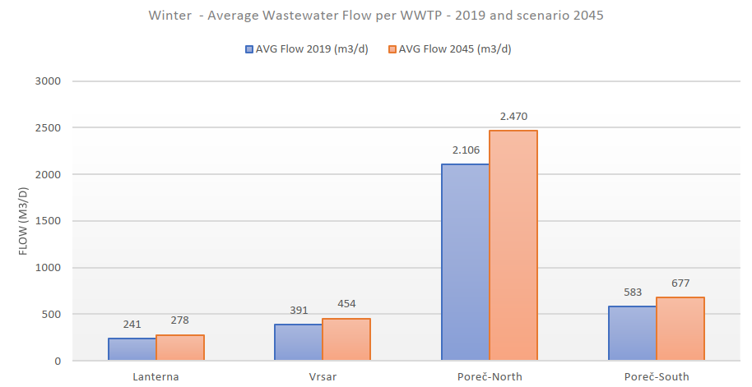
Variables in the scenario study
4 WWTP’s; Vrsar, Lanterna, Poreč-North and Poreč-South
High load summer conditions and low load winter conditions
Current loading and prognosis to 2045 (growth of domestic, tourists and industry)
Days of the week (e.g., Monday hotel cleaning peak)
Hours of the day (morning peak and nightly minimal)
Dry weather and rain weather days
Peak loading events (e.g., incidental industrial discharge)

Slide 12
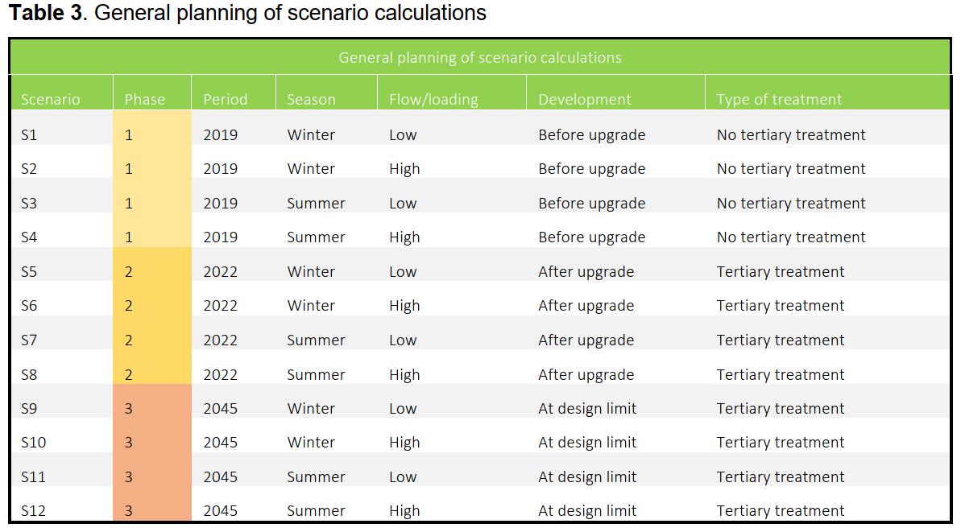
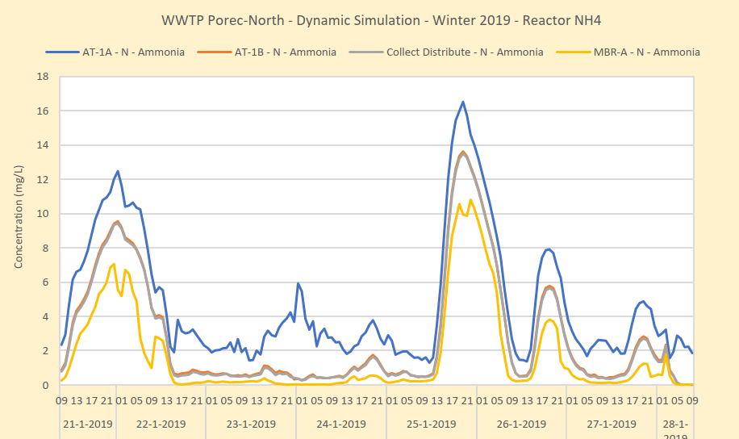
General conclusions of the scenario study
Design retrofitted without significant adjustment of typical model settings.
Design tested under static and dynamic conditions, meets effluent requirements under all scenarios.
Models validated using 2022 operational data.
Operation is not typical for domestic WWTP’s.
Operational challenges expected due to the large load variation (summer winter).
Modeling can improve operational insight.
Operational scenarios studied in this project
Occurrence of high effluent NH4 peak loading Poreč-North predicted by BioWin modeling

Slide 13
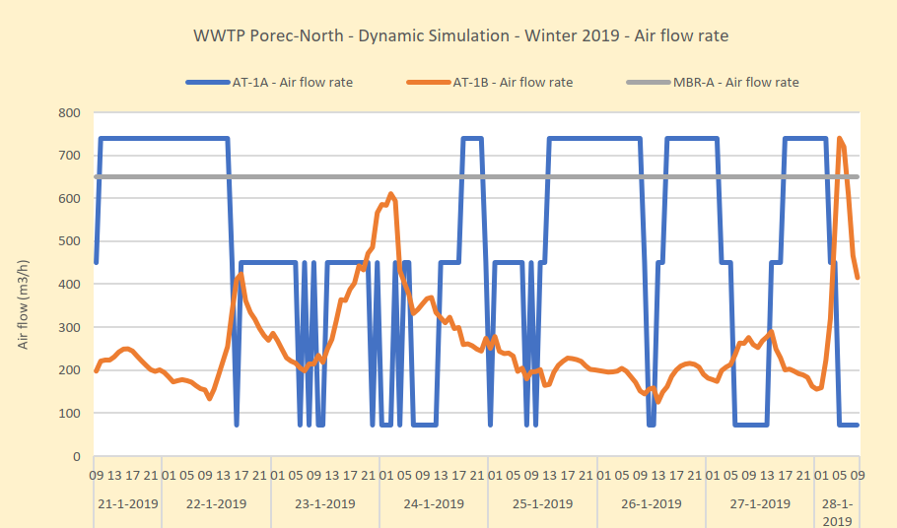
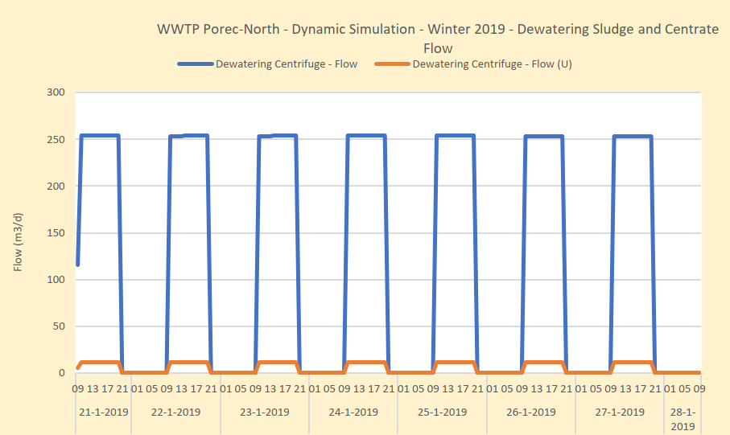
Operational challenges
Simulating realistic operational conditions
Putting in practice effective process control
Sludge dewatering operation and logistics
Influent (pump) flow dynamics
Dynamic aeration control
Dewatering 10 hours per day
BioWin dynamic controller toolbox

Slide 14
BioWin software training at Odvodnja Poreč
Learning goals:
general introduction in the use of BioWin software and WWTP modelling
Introduction on the developed models in this project
emphasis on practical application
Deliverables:
BioWin/Controller license
All relevant files including WWTP models, scenario’s, influent and other data models
Training materials and reference documentation
During the training participants (re)built the model of Poreč-North including controllers

Slide 15
Practical use of WWTP modeling
Future Effluent Requirements Max Process Loading
Scenario evaluation
Choice of process
System choice
Preliminary Design
Final Design
Functional Design
Education
Start-up
Optimization
Problem Solving
Prognosis
Detecting failures
Testing Solutions
Determining volumes
Design loads
Sludge production SRT
Influent Dynamics
Temp. variations
Pump Flow design
Aeration capacity
Use of Chemicals
Effluent quality
Optimizing controllers
Operational cost reduction
2022
Start-up procedure
Forecasting results
Bio adaptation time
Process control design
Process monitoring
Aeration type
Operational management
Training operators
Risk evaluation
What if scenario’s

Slide 16
Thank you for your attention

